Slide 1
PTA
General Membership Meeting
Welcome!

Slide 2

Agenda
Introductions
PTA Priorities
Budget Overview
Update with Mr. Underhill
After-school activities, Mr. Carter

Slide 3
Meet Our Leaders
Treasurer:
Cheryl Brewer
Recording Sec:
Stephanie Angle
Fundraising:
Allison Mueller
Membership:
Mary Frances Daley
Communications: Emma Damsky/Gretchen Kearney
Volunteer Coordin:
Kristin Banz

Slide 4
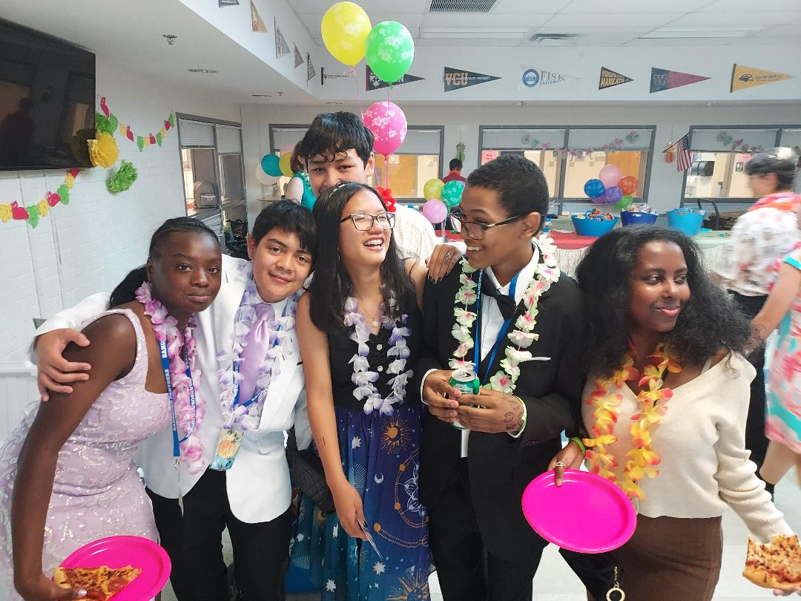
Priorities: what’s the plan?
CSMS Clean-Up Day
October 7, 9-11am
Teacher Appreciation
Upcoming Events: 10/19, 12/13
Honor Roll Recognition
Care & Share
Food Drive
Food for Neighbors
8th Grade Dance / end of year
Date tbd
End of quarter
Toiletry Drive

Slide 5



Fundraising!
How do we do these things?
Poinsettia Sale
Spirit Wear
Restaurant Nights

Slide 6
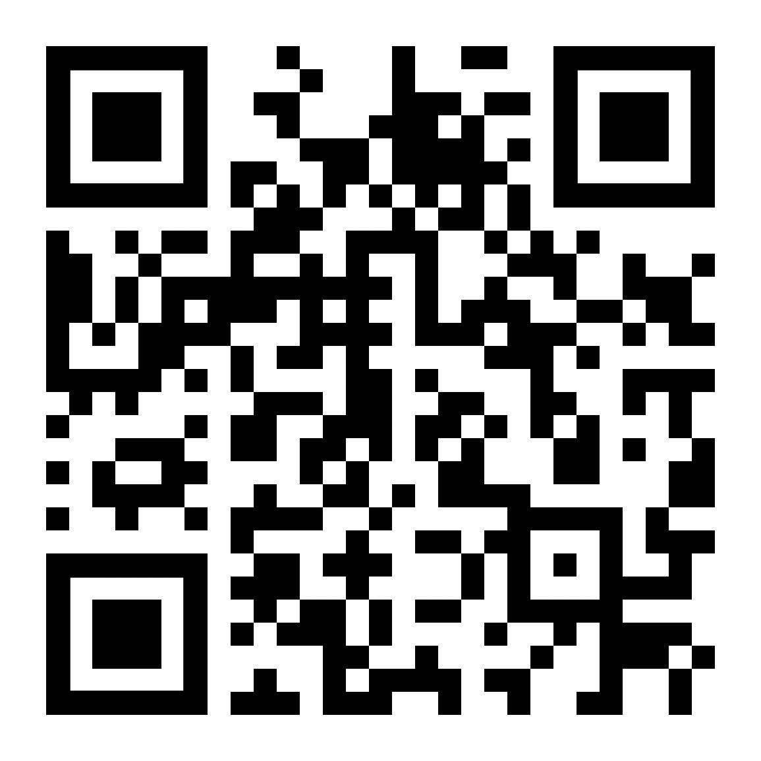
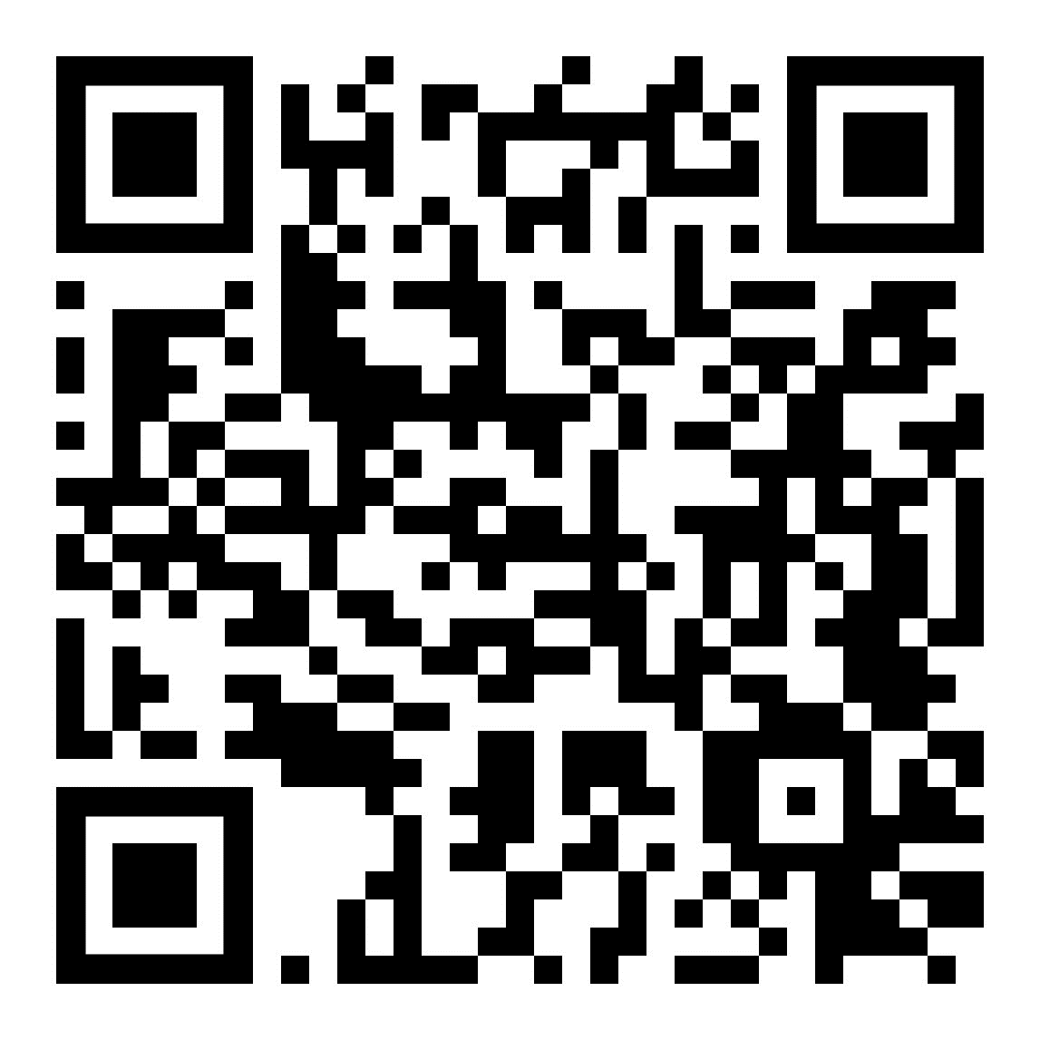
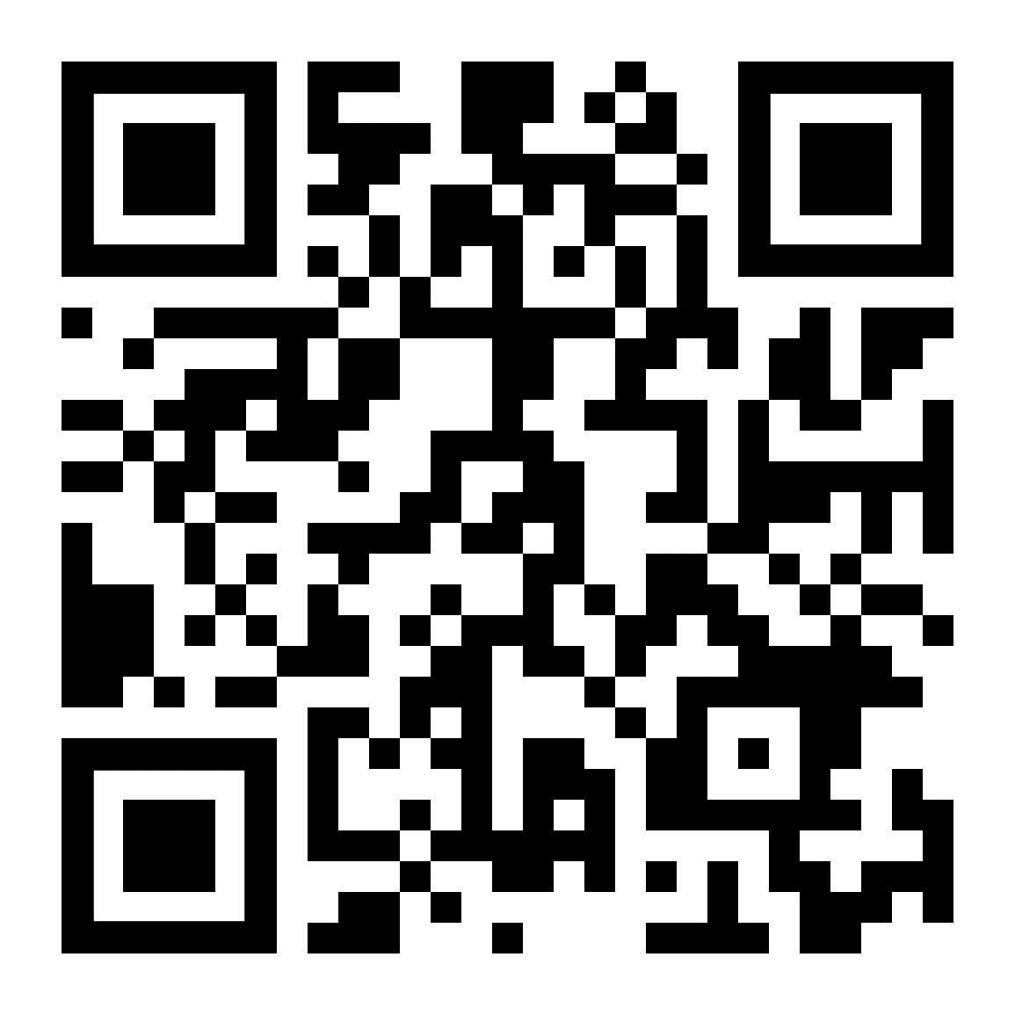



FOLLOW US!
Stay informed about school news, events, volunteer opportunities, etc.
@sandburgmspta Carl Sandburg Middle School PTA @sandburg_ms_pta

Slide 7

How Can You Help?
Care & Share Coordinator
Teacher Appreciation Coordinator
Web-site design
“Reliable Volunteer”
Donate
Spread the word

Slide 8
Budget Overview
2023-2024

Slide 9
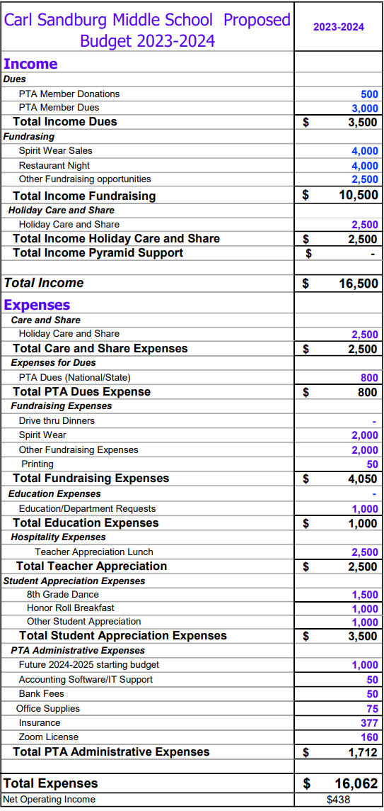

Slide 10
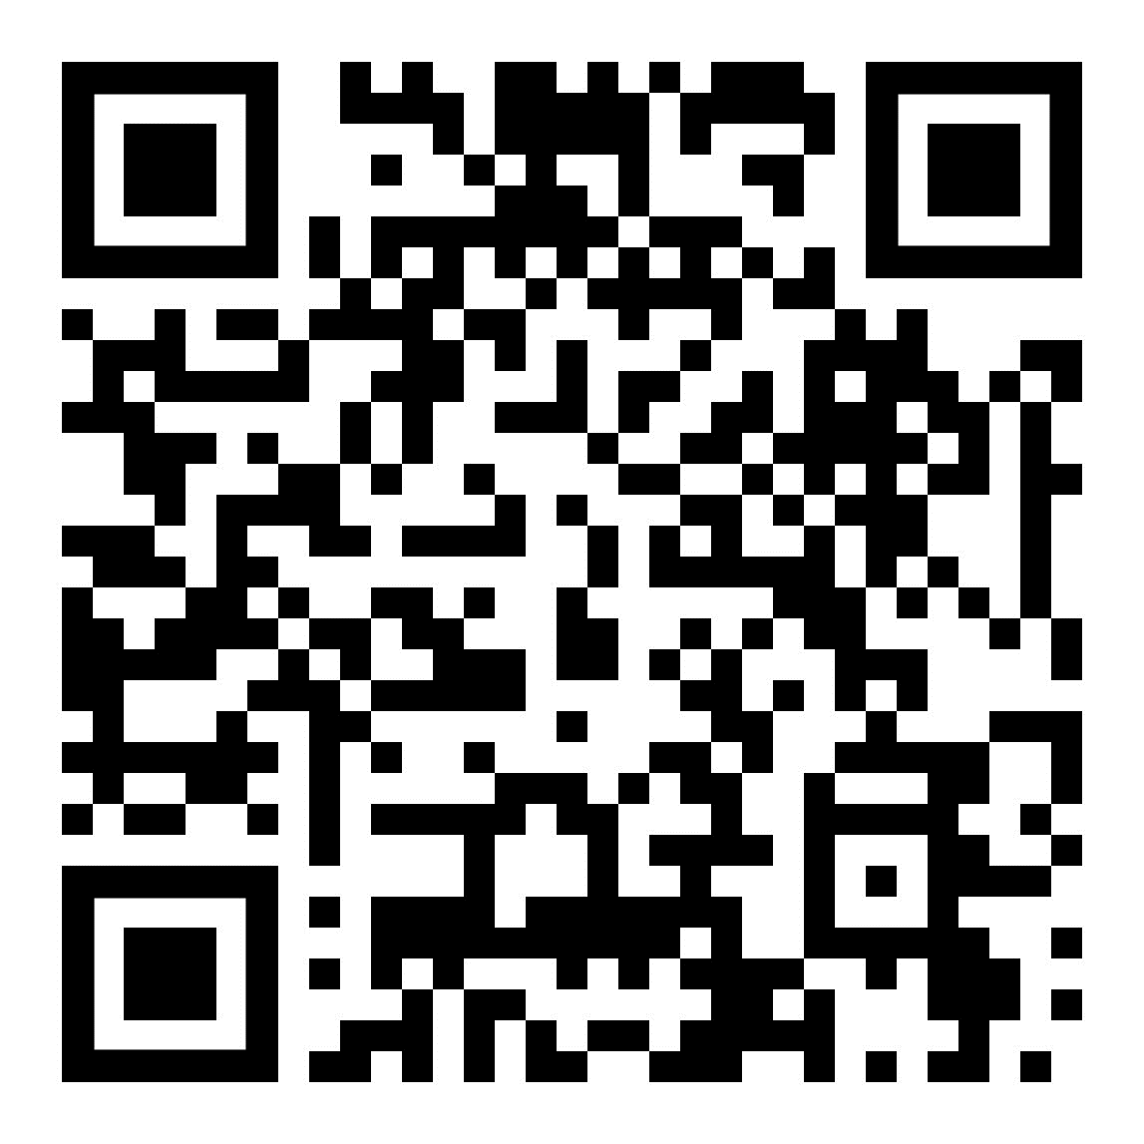
Join Our PTA
Membership Dues:
$20 Family / $10 Faculty

